Slide 1

Artificial Intelligence Lecture 05: Problem Solving Through Search
Farhad Muhammad Riaz

Slide 2
Problem-Solver Formulation
A problem is defined by five items:
An Initial state, e.g., “In Arad“
Possible actions available, ACTIONS(s) returns the set of actions that can be executed in s.
A successor function S(x) = the set of all possible {Action–State} pairs from some state, e.g., Succ(Arad) = {<Arad → Zerind, In Zerind>, … }
Goal test, can be
explicit, e.g., x = "In Bucharest
implicit, e.g., Checkmate(x)
Path cost (additive)
e.g., sum of distances, number of actions executed, etc.
c(x,a,y) is the step cost, assumed to be ≥ 0
A solution is a sequence of actions leading from the initial state to a goal state.

Slide 3
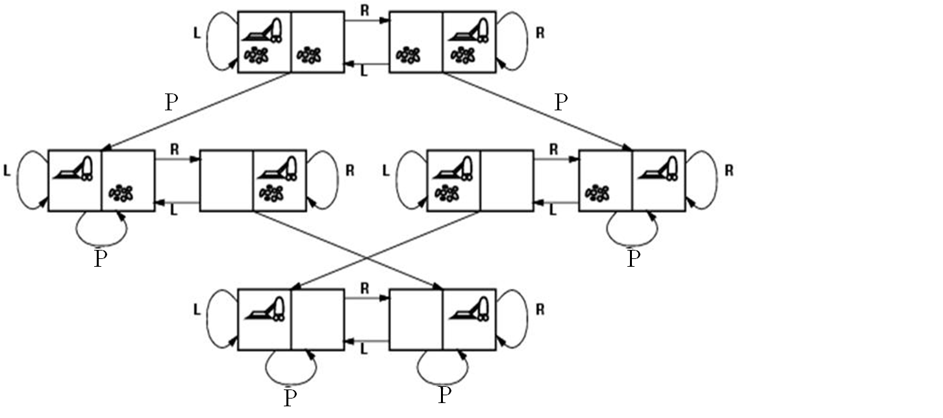
Vacuum World State Space Graph
States? Actions?
Goal test? Path cost?

Slide 4
States? dirt and robot location
Actions? Left, Right, Pick
Goal test? no dirt at all locations
Path cost? 1 per action

Slide 5
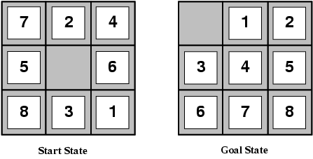
Example: The 8-puzzle
States?
Actions?
Goal test?
Path cost?

Slide 6
States? locations of tiles
Actions? move blank left, right, up, down
Goal test? = goal state (given)
Path cost? 1 per move
[Note: optimal solution of n-Puzzle family is NP-hard]

Slide 7
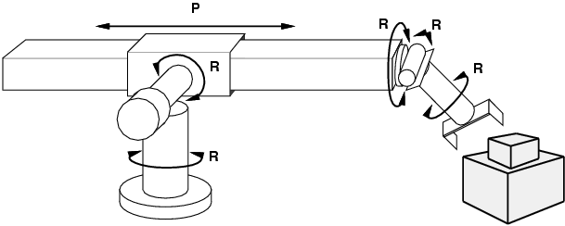
Example: Robotic Assembly
States?: real-valued coordinates of robot joint angles, parts of the object to be assembled, current assembly
Actions?: continuous motions of robot joints
Goal test?: complete assembly
Path cost?: time to execute

Slide 8
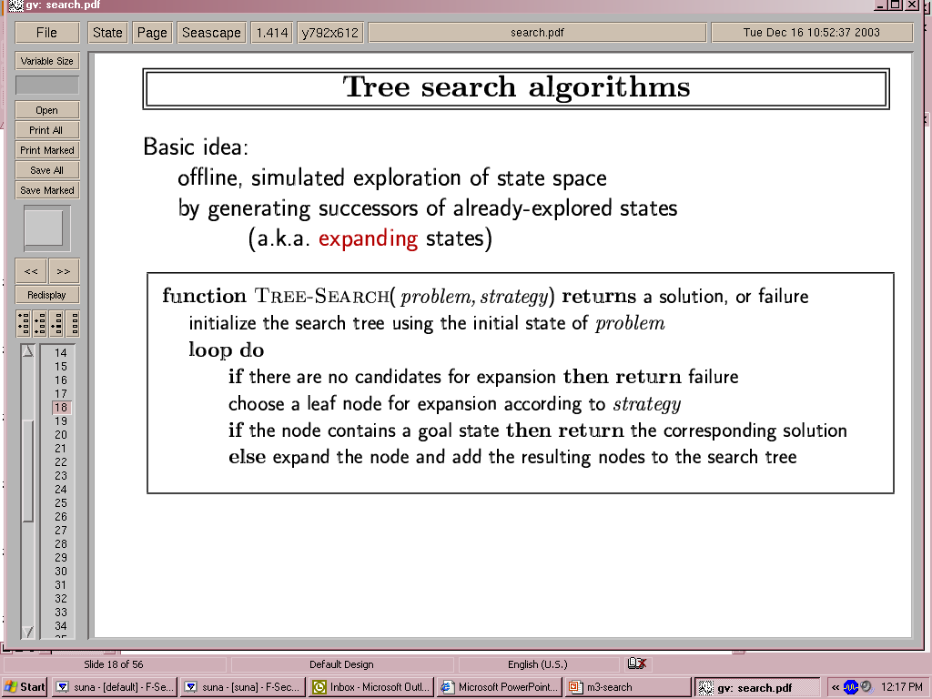
Tree Search Algorithms
Basic idea:
Offline (not dynamic), simulated exploration of state space by generating successors of already-explored states (a.k.a. expanding the states)
The expansion strategy defines the different search algorithms.

Slide 9
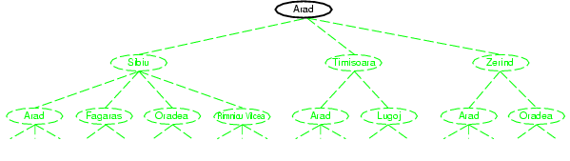
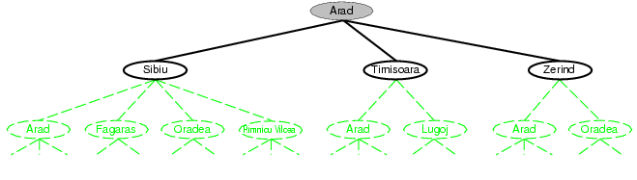
Tree search example

Slide 10
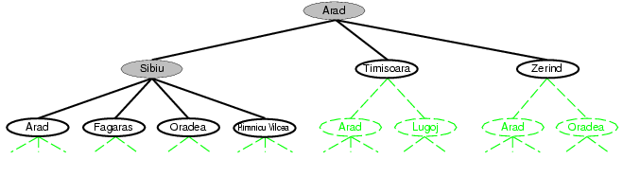

Slide 11
Fringe
Fringe: The collection of nodes that have been generated but not yet expanded
Each element of the fringe is a leaf node, with (currently) no successors in the tree
The search strategy defines which element to choose from the fringe

Slide 12
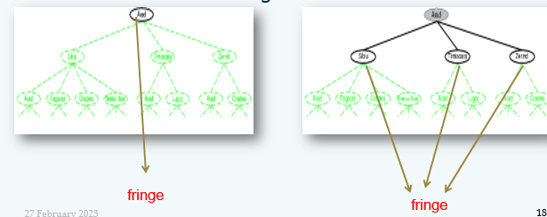
Fringe

Slide 13
Implementation: States vs. Nodes
A state is a representation of a physical configuration
A node is a data structure constituting part of a search tree includes state, parent node, action, path cost g(x), depth
The Expand function creates new nodes, filling in the various fields and using the SuccessorFn of the problem to create the corresponding states.

Slide 14
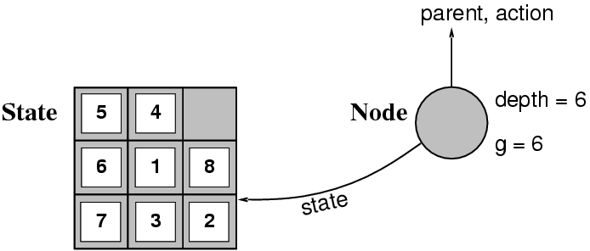
Implementation: States vs. Nodes

Slide 15
Search Strategies
A search strategy is defined by picking the order of node expansion
Strategies are evaluated along the following dimensions:
Completeness: Does it always find a solution if one exists?
Time complexity: Number of nodes generated
Space complexity: Maximum number of nodes in memory
Optimality: Does it always find a least-cost solution?
Time and space complexity are measured in terms of
b: maximum no. of successors of any node
d: depth of the shallowest goal node
m: maximum length of any path in the state space.

Slide 16
Uninformed Search
Uninformed: While searching you have no clue whether one non-goal state is better than any other. Your search is blind. You don’t know if your current exploration is likely to be fruitful.
Various blind strategies:
Breadth-first search
Uniform-cost search
Depth-first search
Iterative deepening search

Slide 17
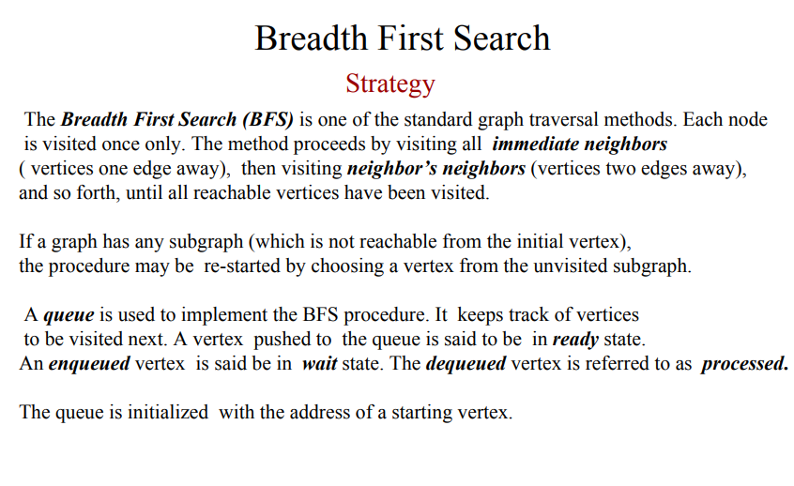
Breadth-first search

Slide 18
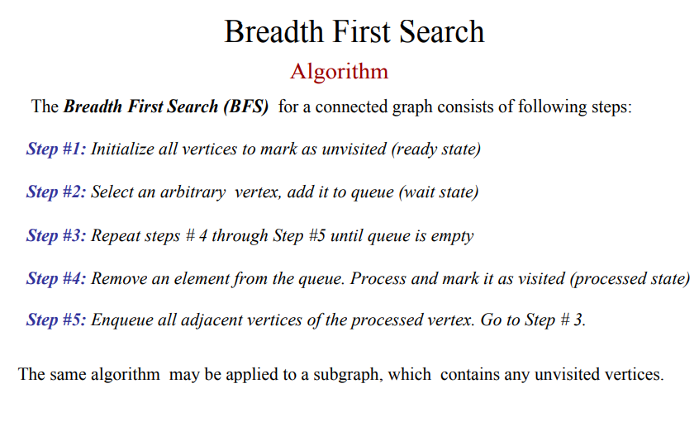
Breadth-first search

Slide 19
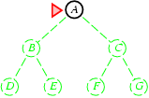
Breadth-first search
Expand shallowest unexpanded node
Fringe: nodes waiting in a queue to be explored
Implementation:
fringe is a first-in-first-out (FIFO) queue, i.e., new successors go at end of the queue.
Is A a goal state?

Slide 20
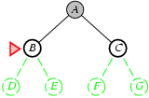
Breadth-first search
Expand shallowest unexpanded node
Implementation:
fringe is a FIFO queue, i.e., new successors go at end
Expand:
fringe = [B,C]
Is B a goal state?

Slide 21
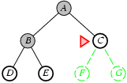
Breadth-first search
Expand shallowest unexpanded node
Implementation:
fringe is a FIFO queue, i.e., new successors go at end
Expand:
fringe=[C,D,E]
Is C a goal state?

Slide 22
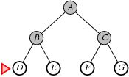
Breadth-first search
Expand shallowest unexpanded node
Implementation:
fringe is a FIFO queue, i.e., new successors go at end
Expand:
fringe=[D,E,F,G]
Is D a goal state?

Slide 23
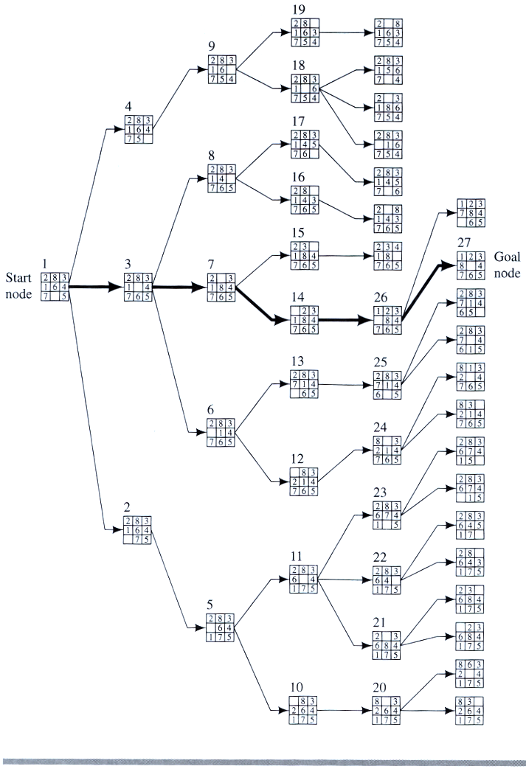
Breadth-first search

Slide 24
Properties of breadth-first search
Complete? Yes it always reaches goal (if b is finite)
Time? 1+b+b²+b³+… +b^{d} + (b^{d+1}-b)) = O(b^{d+1})
(this is the number of nodes we generate)
Space? O(b^{d+1}) (keeps every node in memory,
either in fringe or on a path to fringe).
Optimal? Yes (if we guarantee that deeper solutions are less optimal, e.g. step-cost=1).
Space is the bigger problem (more than time)

